Slide 1
Workflow Management
Rex

Slide 2
Background/Context
Sms Assist’s business is around work order, proposal, and invoice.
Currently, the code contains lots of if…else… to switch among actions and statuses.
WorkflowManagement
is a classes library that can help user to know the next status using previous status and action, the project is based on state pattern.

Slide 3
Benefit of the WorkflowManagement(Lib)
Pros
The single responsibility principal places code related to a particular state in a separate class.
Open-Close principle. No need to change the existing status and context to add a new state.
Reduce the redundant "if ... else..."
reduce the maintenance cost for the whole life cycle
Lowering the learning curve for new Software Developer
Pros
If there aren't not enough status, the state pattern is not necessary

Slide 4
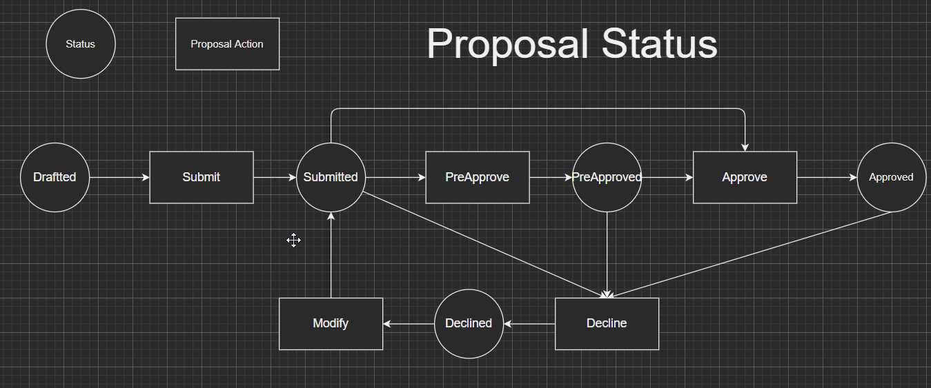
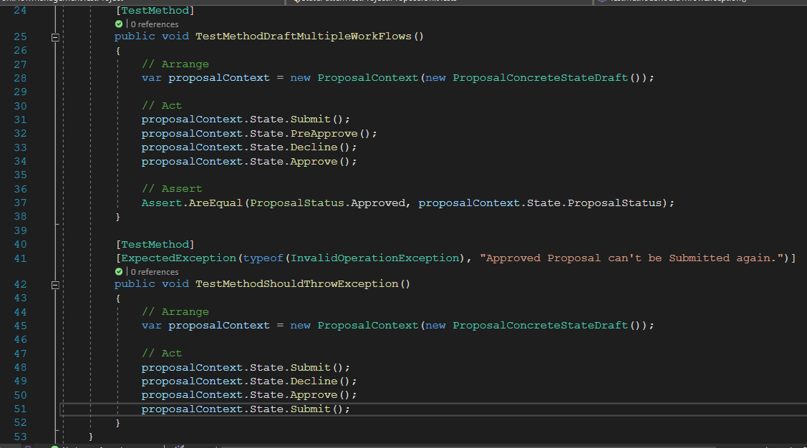
Flow Chart – Proposal

Slide 5
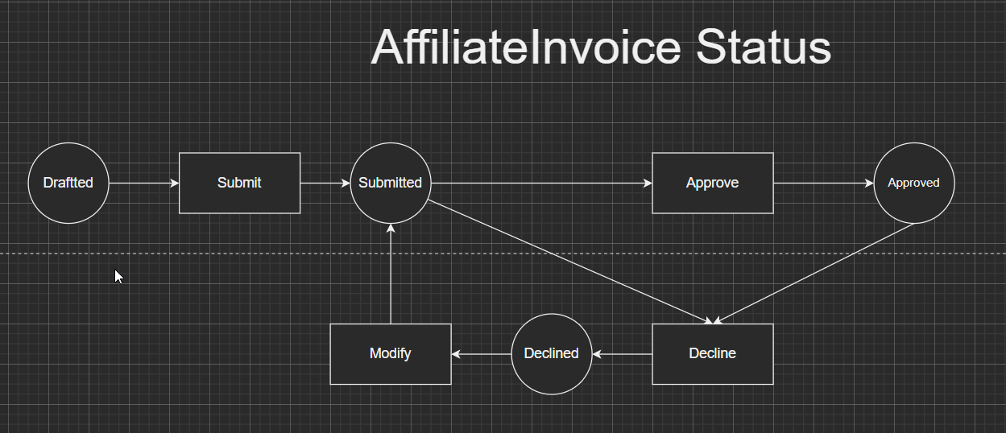
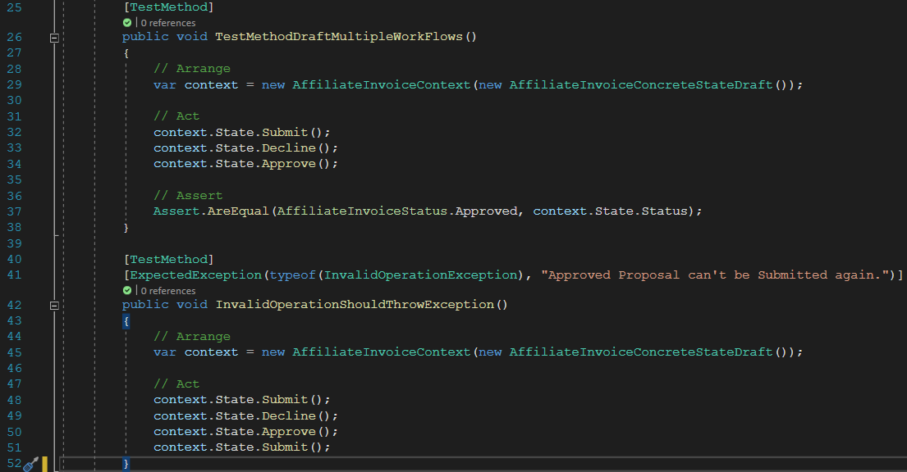
Flow Chart – AffiliateInvoice Status

Slide 6
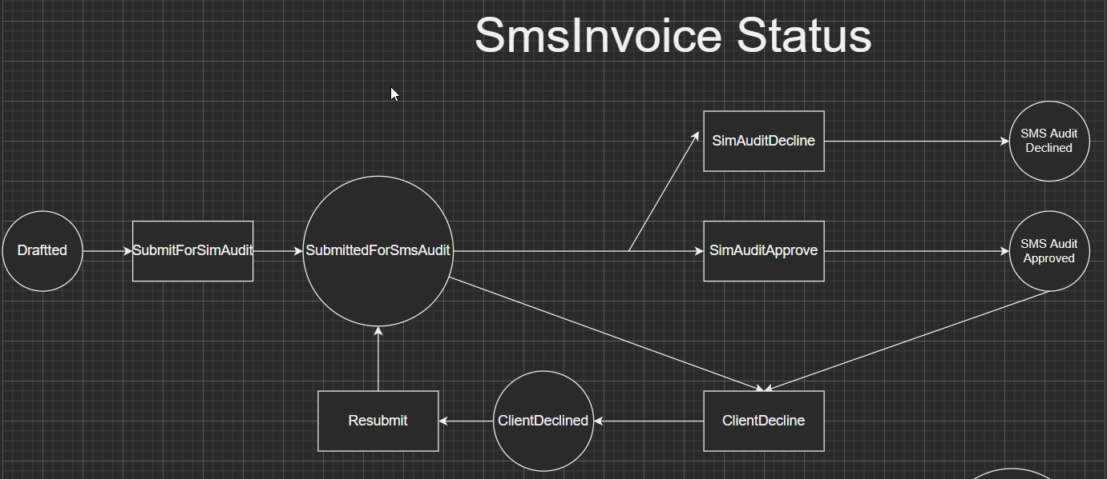
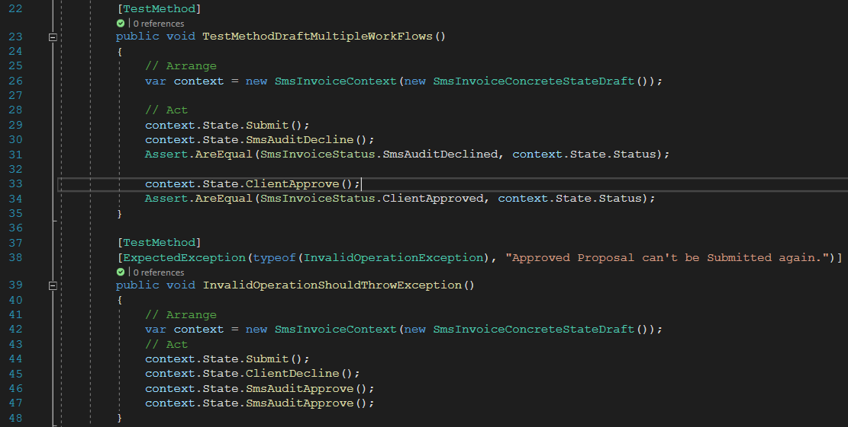
SmsInvoice Status

Slide 7
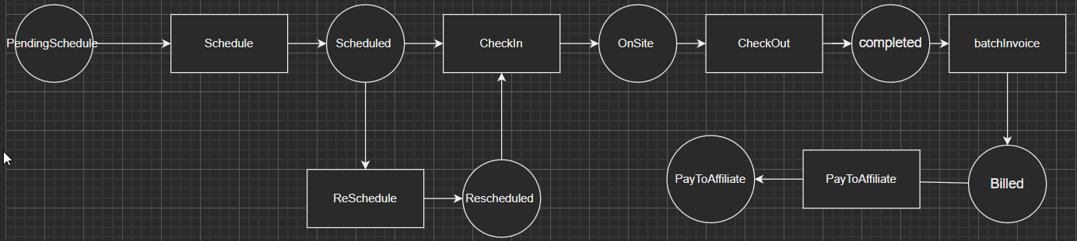
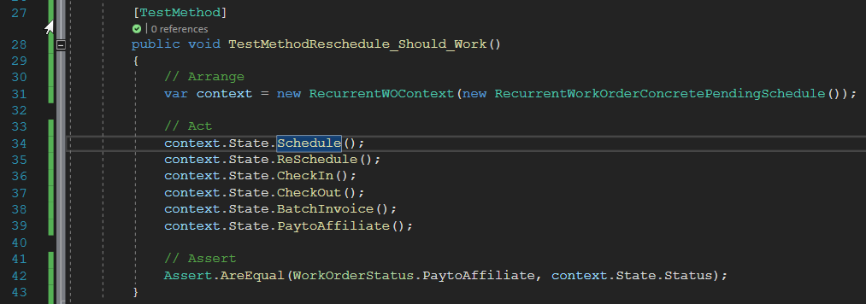
Recurrent Work Order Status

Slide 8
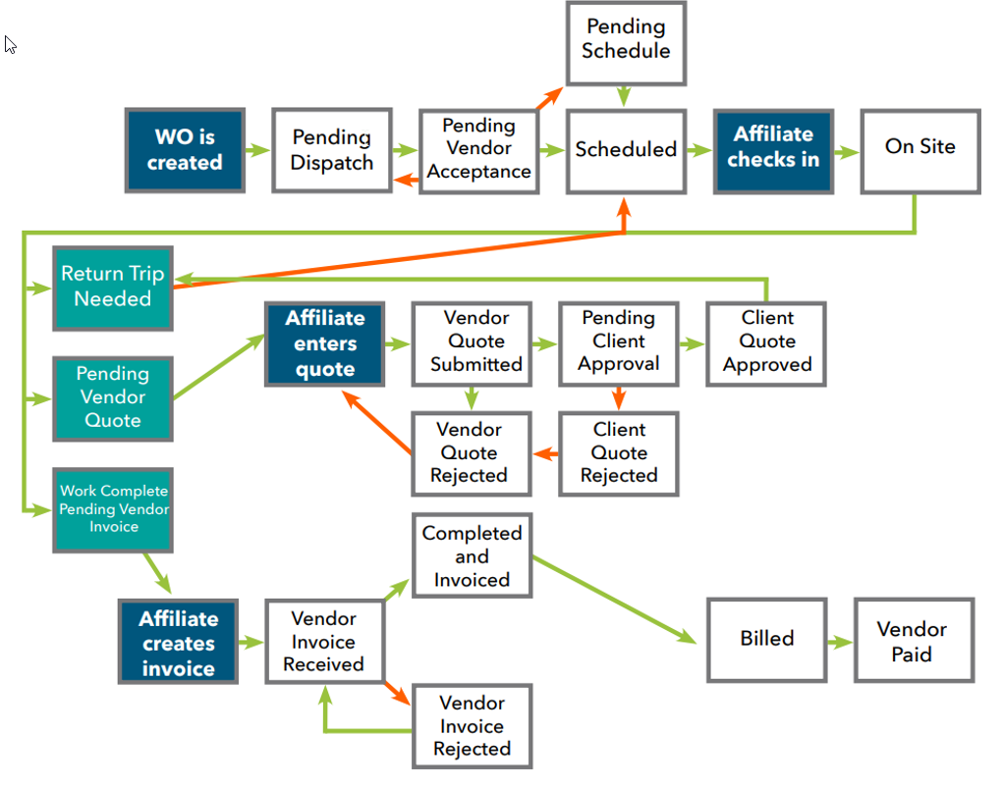
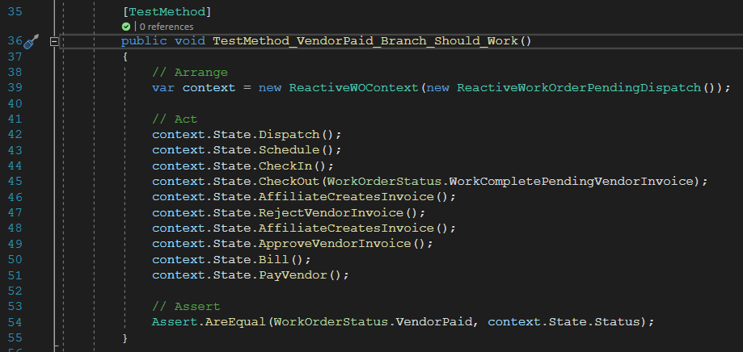
Reactive Work Order Status

Slide 9
Workflow Management - Next
Workflow Management V1.0 only covered the major case of the status and actions. Lots of cases need to be added in the upgraded version.
Questions: Which repo should be used to store the code?

Slide 10
Thanks!

